Slide 1





PacketRadar
Live Network Traffic Monitoring & PCAP Analysis Dashboard
ORGANIZATION
SUBMITTED BY
PROGRAM & INSTITUTION
SAG, DRDO (Delhi)
Yatin Parashar(CS-23411426)
B.Tech CSE | IILM University

Slide 2


Organization Profile
Defence Research & Development Organisation
Scientific Analysis Group (SAG)
DRDO is India's premier agency for defense technology research and development under the Ministry of Defence, powering national security through advanced indigenous systems.
Located in Metcalfe House, Delhi, SAG specializes in cutting-edge research in cryptography, cyber security, information security, and secure communication systems for critical defense networks.

Slide 3

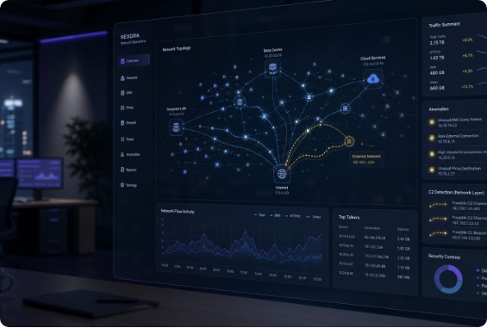
Problem Statement
Fragmented Network Monitoring Tools
Tool Switching Overhead: Security analysis typically requires switching between Wireshark, tcpdump, and custom scripts.
Lack of Unified Real-Time Views: Command-line log outputs make it challenging to spot live traffic anomalies and host behaviors intuitively.
Need for Automated Heuristics: Manual inspection of raw packet headers slows down basic threat detection like port scans or spoofing.

Slide 4








Core Project Objectives
Live Traffic Streaming
Offline PCAP Parsing
Automated Threat Rules
Executive Reporting
Capture host network packets in real time and stream summarized statistics to a web UI via WebSockets.
Enable offline PCAP/PCAPNG file upload for deep inspection without requiring active network sniffing.
Implement rule-based engines to flag Port Scans, ARP Spoofing, DNS Tunneling, SYN Floods, and Exfiltration.
Auto-generate downloadable PDF analysis reports containing charts, tables, and security recommendations.

Slide 5








System Architecture
1. Capture & Parsing
2. Analytics Engines
3. API & WebSockets
4. Frontend & PDF
Scapy background sniffer converts Ethernet, ARP, IP, TCP, UDP, ICMP, and DNS frames into a standardized PacketModel.
Computes protocol distribution, top talkers, host conversations, timeline statistics, and runs 6 threat detection rules.
FastAPI handles REST queries and low-latency WebSocket live data streams to deliver immediate UI feedback.
React dashboard renders Chart.js widgets, while ReportLab and Matplotlib assemble downloadable multi-page PDF reports.

Slide 6

Technology Stack
Layer | Technologies / Frameworks | Key Role & Responsibility
Frontend | React 18, TypeScript, Vite, Tailwind CSS | High-performance, responsive UI components and state management.
Visualization | Chart.js, react-chartjs-2, Lucide Icons | Interactive real-time pie, bar, and timeline traffic charts.
Backend API | Python, FastAPI, Uvicorn, Pydantic | Asynchronous REST endpoints, data validation, and WebSockets.
Packet Engine | Scapy, psutil | Live packet capture, PCAP file parsing, process mapping.
Reporting | ReportLab, Matplotlib | Automated PDF document generation with embedded charts.

Slide 7

Behavioral Threat Engine
PacketRadar incorporates 6 independent heuristic rules to flag suspicious traffic patterns in real time:
Port Scan & SYN Flood: Flags rapid connection probes & incomplete TCP handshakes.
ARP Spoofing: Detects duplicate IP-to-MAC mappings and cache poisoning.
DNS Tunneling & Exfiltration: Flags high-entropy domain queries and abnormal payloads.

Slide 8

Key Outcomes & Deliverables
Dual-Mode Monitoring: Seamless toggling between live interface streaming and offline PCAP uploads.
6
Automated PDF Reporting: One-click generation of executive security reports complete with visual metrics.
Integrated Threat Engines
Production Deployment: Backend deployed on Railway, confirming robust end-to-end cloud pipeline validation.

Slide 9


Thank You!
Successfully developed and delivered PacketRadar as part of the industrial training requirement at SAG, DRDO.
Questions & Discussion
Yatin Parashar | B.Tech CSE | CS-23411426

